Slide 1

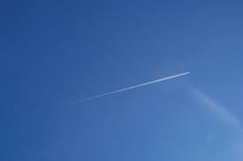
Challenge: Clouds or Contrails
Cloud
Contrail

Slide 2
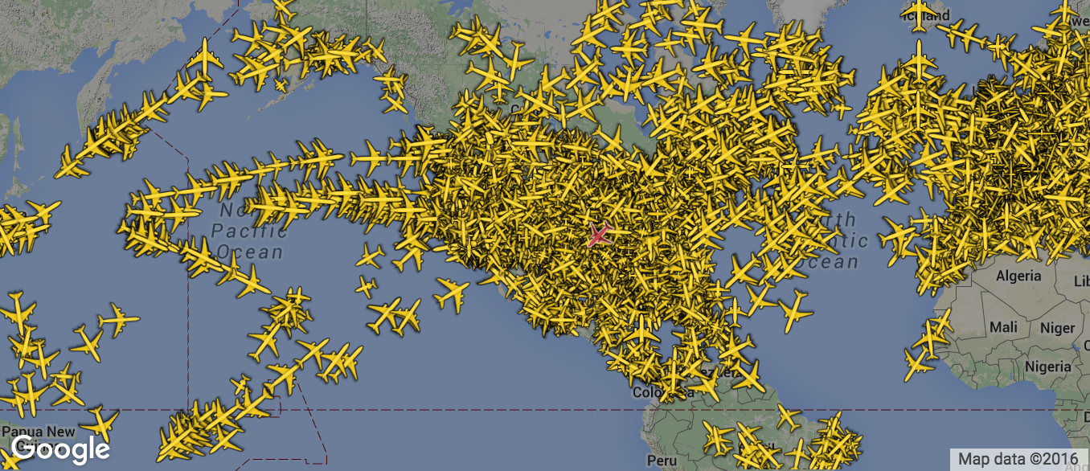
3,000,000

Slide 3
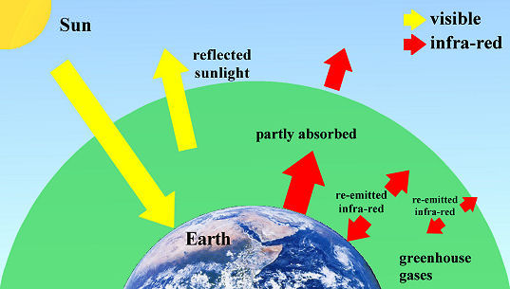
IPCC (2007): “Aircraft condensation trails criss-crossing the sky may be warming the planet on a normal day more than the carbon dioxide emitted by all planes since the Wright Brothers' first flight in 1903, according to a study in Nature Climate Change”

Slide 4
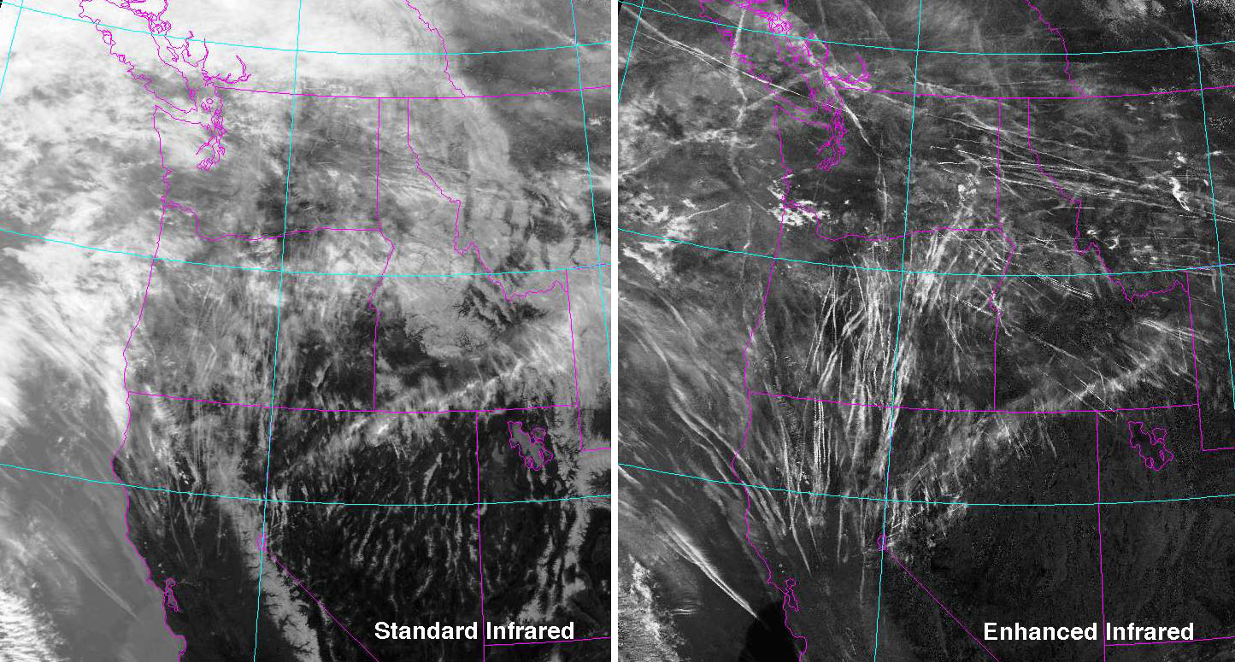

Slide 5

Demo

Slide 6
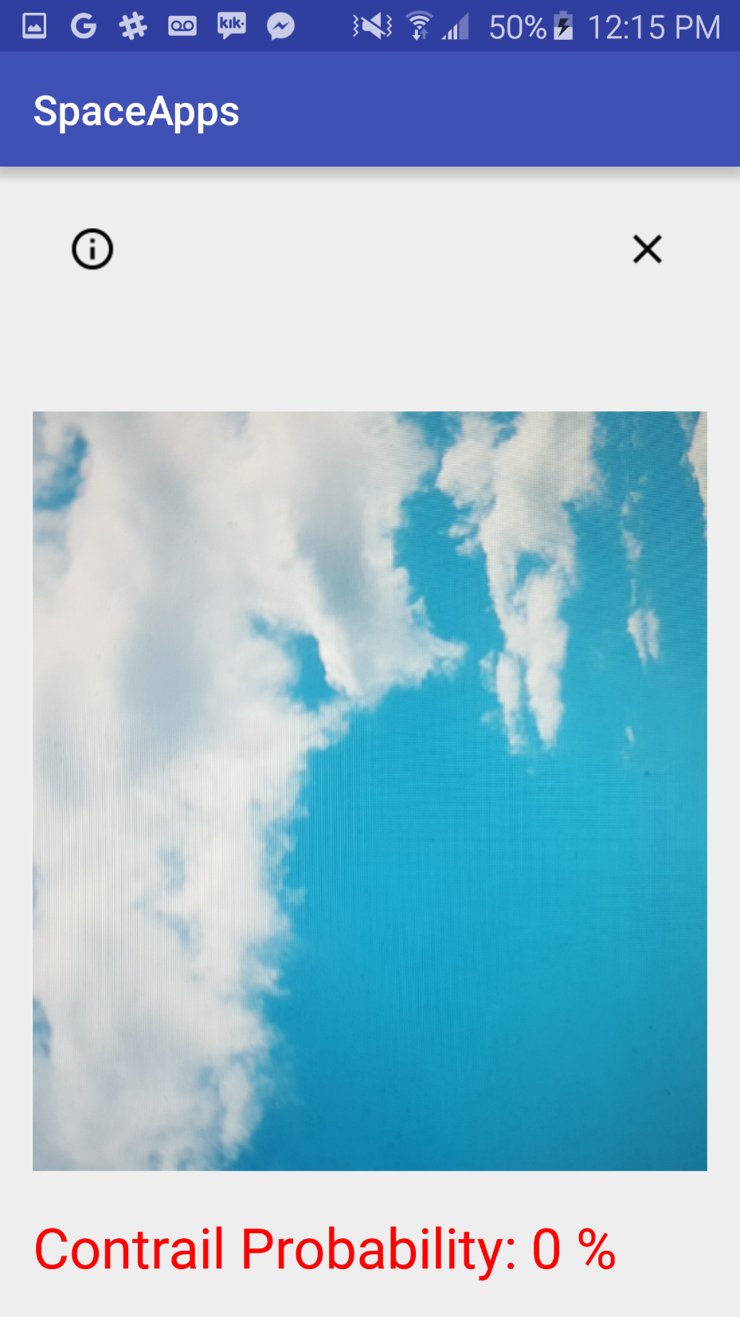
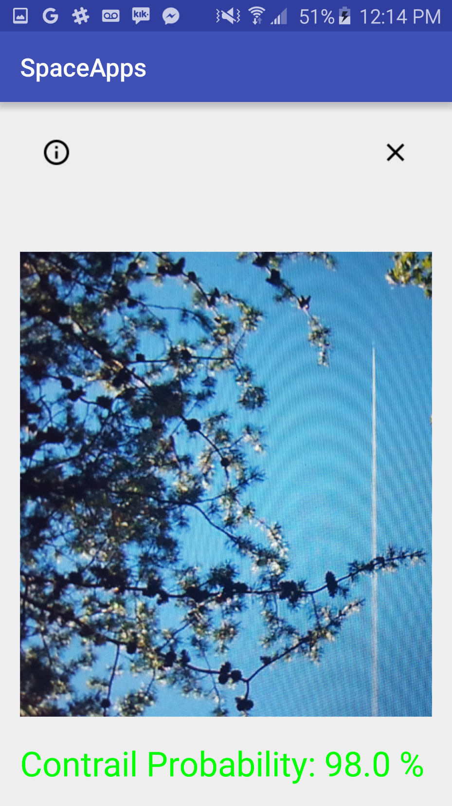

Slide 7
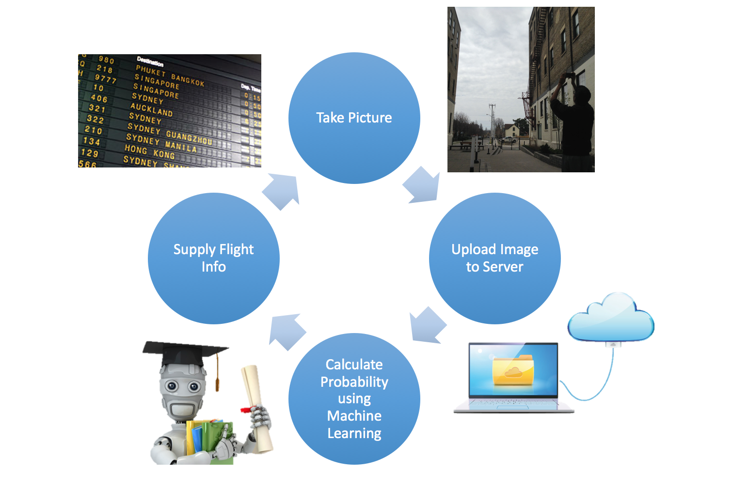
Software Life Cycle

Slide 8
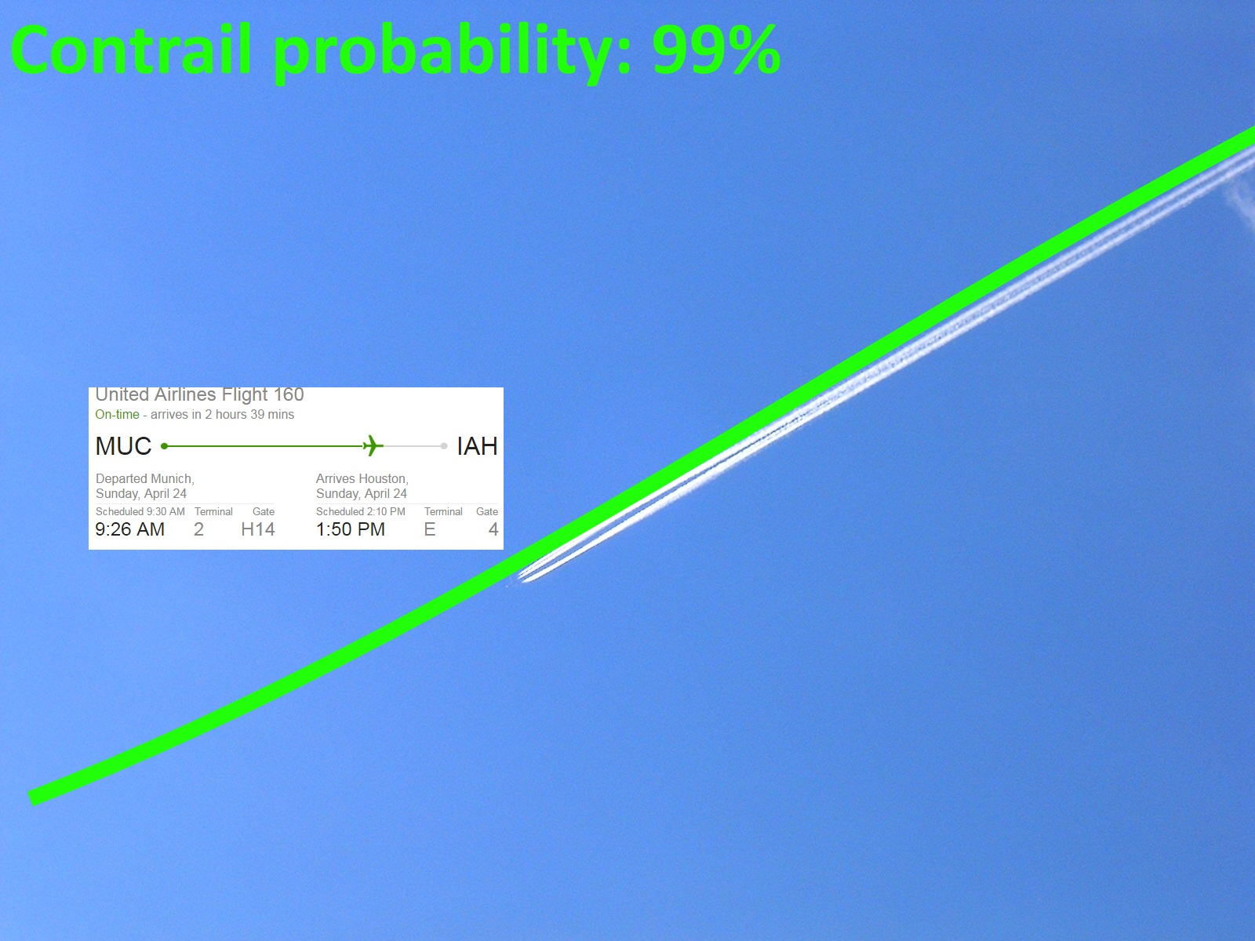
What’s next?
Augmented reality

Slide 9
What’s next?
Ukraine: local weather changes?
Atmospheric geoengineering

Slide 10





Team
Dar Mehta
CompSci
Scott Jones
Astronomy
George Utsin
CompSci
Anmol Mago
CompSci
Vincent Russo
CompSci

Slide 11
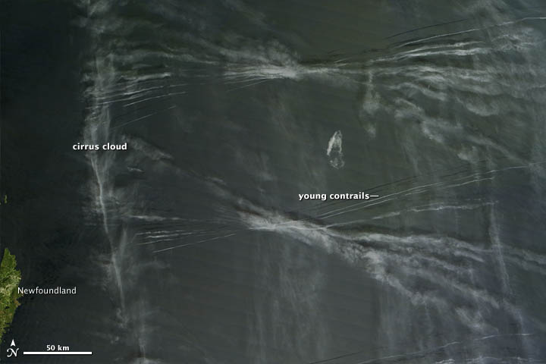
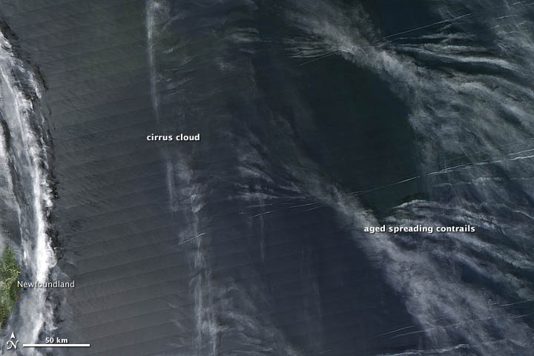
Cirrus cloud cover has increased by 3% from 1971 to 1995 (Minnis et al. 2004)

